Slide 1
Data Structures

Slide 2
Agenda
Application of Graphs
Introduction
Restriction in Trees
Classification of Graphs
Properties of Graphs
Representation of Graphs

Slide 3
Application of Graphs
Representing: Social Networks
Transportation networks, etc.
Graphs help in identifying contacts on social sites and suggesting them as friends on Facebook, where the nodes can be different users and the edges represent the relationships between them.
Graphs help in finding the shortest distance between any two given locations, where nodes can be the different locations in a city and edges represent the routes available between the locations.

Slide 4
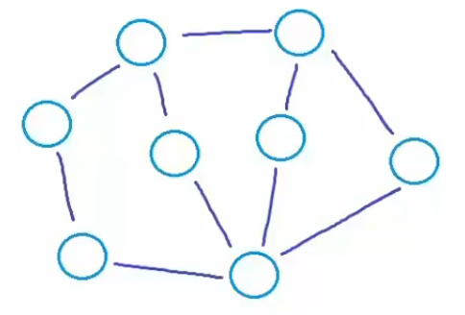
Introduction
Mathematical/Logical Notation:
A graph is an abstract data structure that represents the relationship between multiple nodes (entities) by connecting the nodes with edges.
G = (V, E) Here G is a graph which is a pair of two sets where:
V - It is a finite set of vertices (nodes).
E - It is a finite set of an ordered pair of the form (u, v) called an edge. The pair (u, v) indicates that there is an edge from vertex u to vertex v.

Slide 5
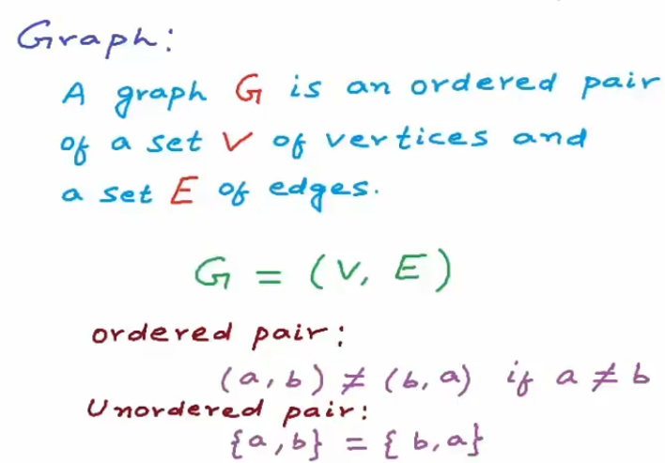
Introduction
Mathematical/Logical Notation:

Slide 6
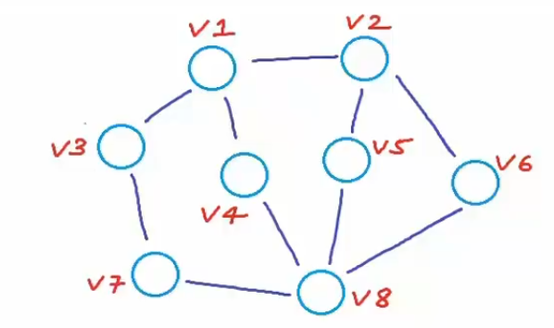
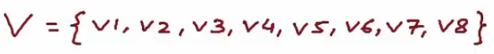
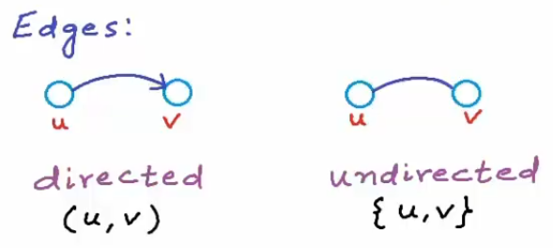
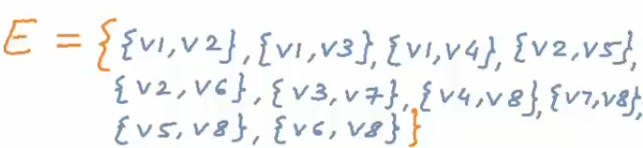
Introduction
Types of Edges:

Slide 7
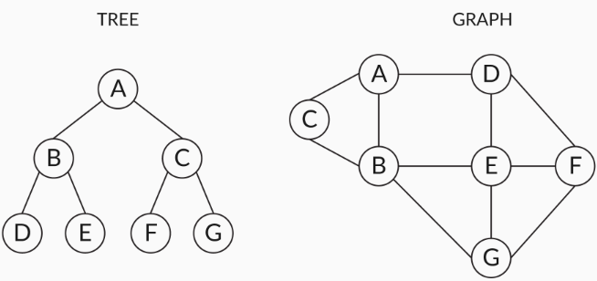
Restriction in Trees
Tree data structures have usage restrictions in representing real-world scenarios as each child node can have only one parent node, if there are N nodes then there will be exactly N-1 edges.
Graph data structures do not follow any restriction like that of the tree data structure on how different nodes are connected to each other.
Let’s look at the two data structures in the following diagram:

Slide 8
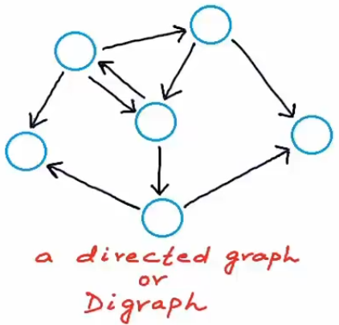
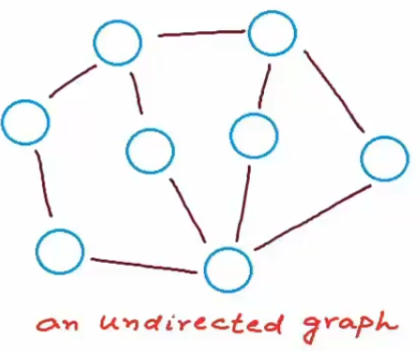
Classification of Graphs
Directed vs Undirected
Directed Graphs: That show an asymmetrical relationship b/w two connected nodes, paired by an edge that indicates the direction of the relationship from one node to another is called a directed graph.
Undirected Graphs: Graphs that show a symmetrical relationship between two connected nodes paired by an edge that represents a simple line is called an undirected graph.

Slide 9
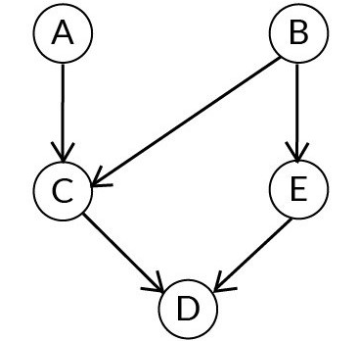
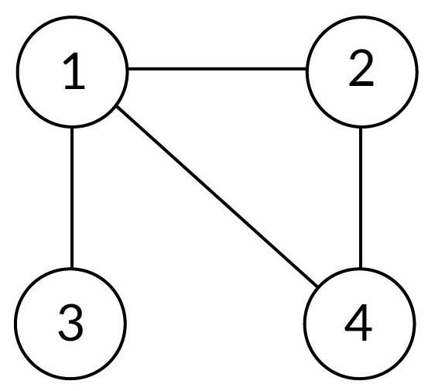
Classification of Graphs
Directed vs Undirected
Directed Graphs
Undirected Graphs
G for the above graph is (V, E) where
V = {A, B, C, D, E}
E = {(A, C), (B, C), (C, D), (E, D), (B, E)}
G for the above graph is (V, E) where
V = {1, 2, 3, 4}
E = {(1, 2), (2, 4), (4, 1), (1, 3)}
Note: The pair representing the edge is ordered and (u,v) ≠ (v,u) in case of a directed graph (digraph) and in case of an undirected graph the order does not matter

Slide 10
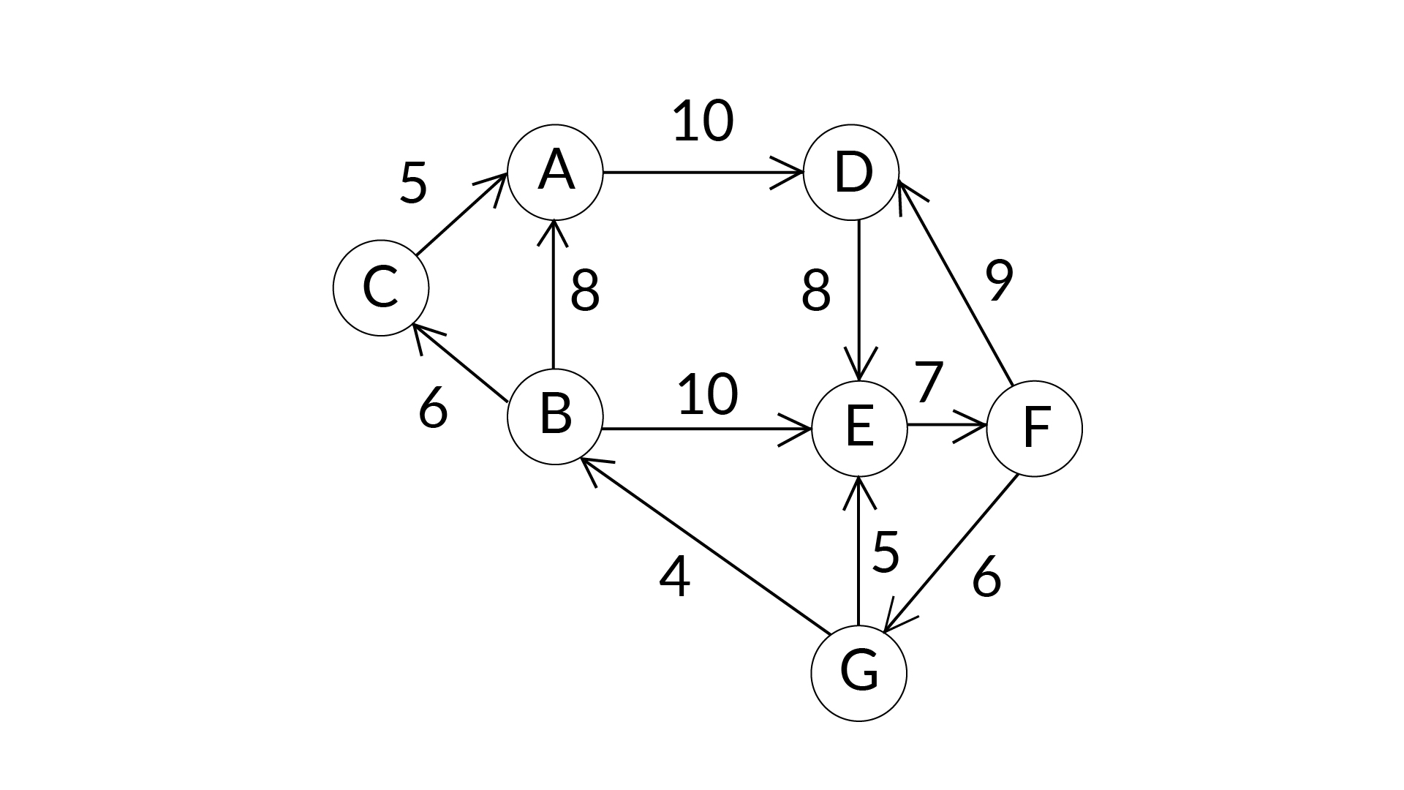
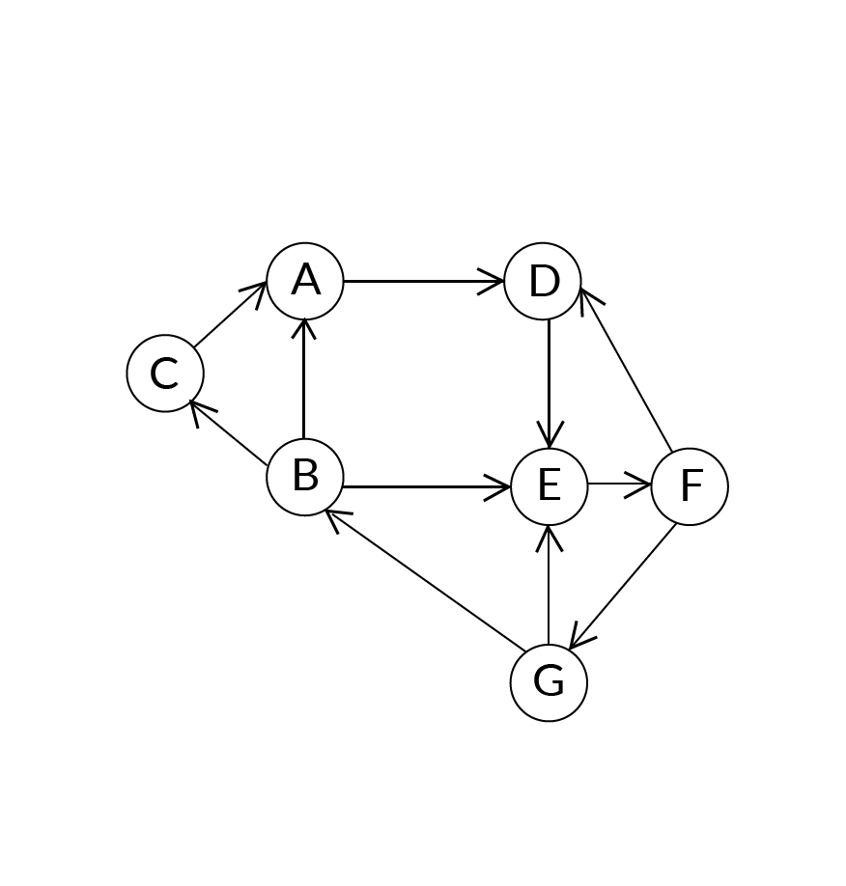
Classification of Graphs
Weighted vs Unweighted
Weighted graph: A graph in which edges contain some weights or values is called a weighted graph.
Unweighted graph: A graph in which edges contain no weight is called the Unweighted graph.
Example: If the nodes in the graph are considered as the cities and edges considered as the paths between them then the weights of these edges can be considered as the distance between these cities.
Or, A weighted graph with all edges having weight = 1 unit.

Slide 11
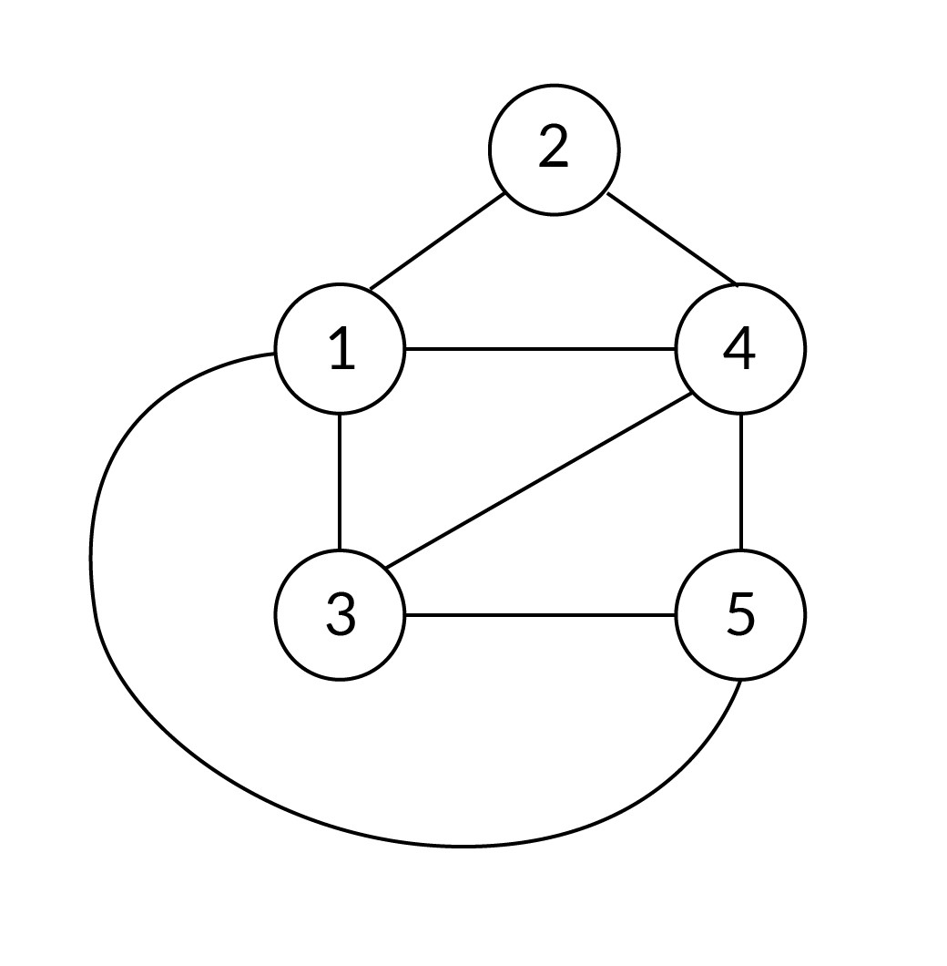
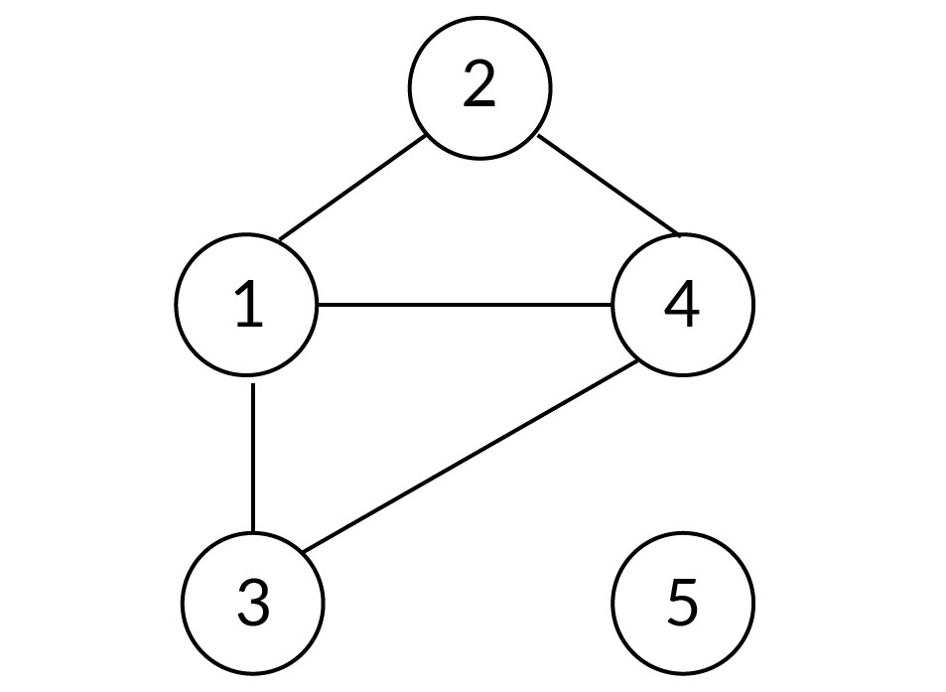
Classification of Graphs
Based on Connectivity
Connected Graph: A Graph is connected if a path exists from every vertex to every other vertex.
Disconnected Graph: A Graph is disconnected if there exist at least two nodes such that there is no path connecting them.

Slide 12
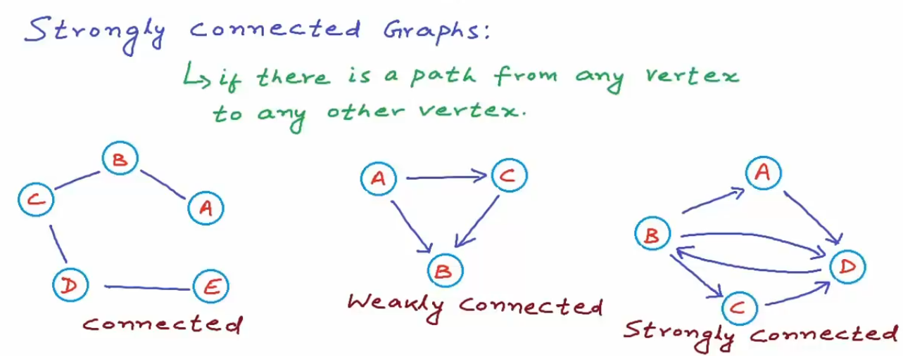
Classification of Graphs
Based on Connectivity

Slide 13
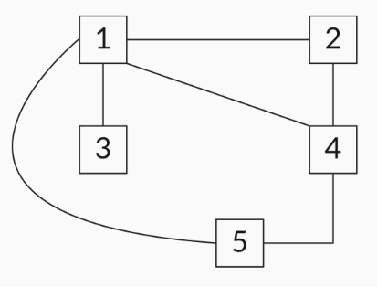
Properties of Graphs
Neighbours: If two nodes are adjacent to each other and connected by an edge, then those nodes are called neighbours.
Degree: The number of edges that are connected to a node is called the degree of the node.
Let’s consider the following undirected graph. We will discuss how to determine the degree of each node.

Slide 14
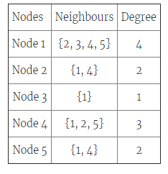
Properties of Graphs
In case of directed graphs, the degree can be classified into:
In-degree: The number of incoming edges to a node
Out-degree: The number of outgoing edges from a node
For a directed graph: Degree = InDegree(the edges pointing to the vertex) + OutDegree(the edges pointing away from the vertex)

Slide 15
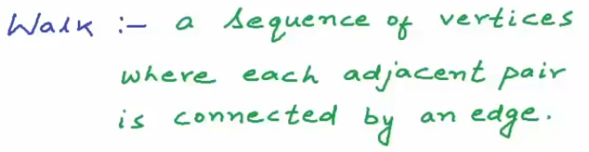
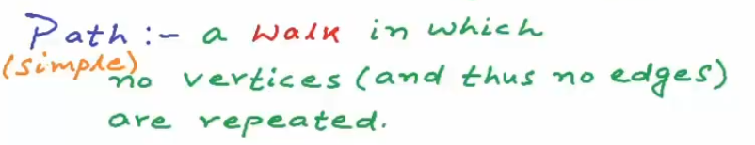
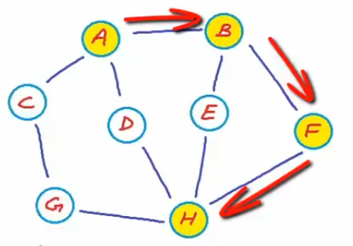
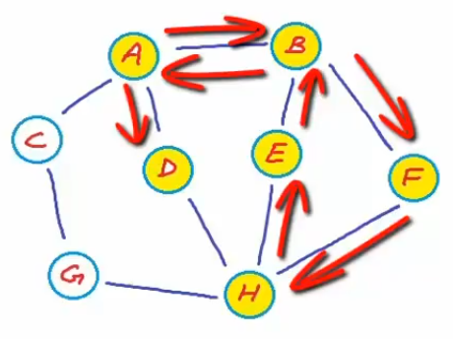
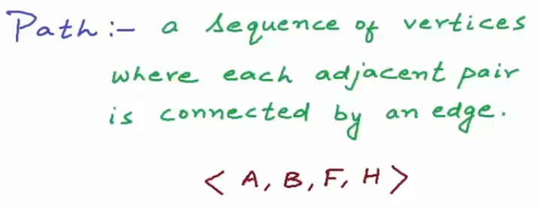
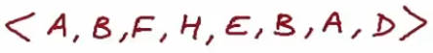
Properties of Graphs
Also a Simple Path
Not a Simple Path

Slide 16
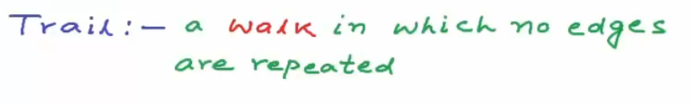
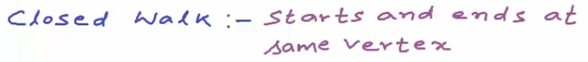
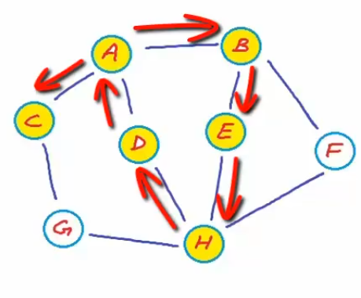
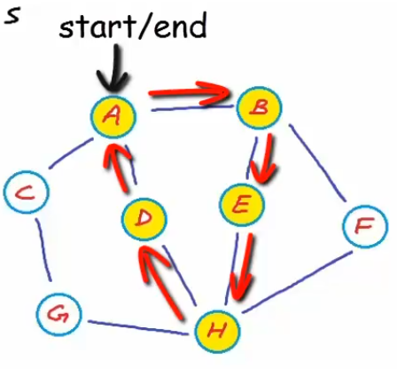
Properties of Graphs

Slide 17
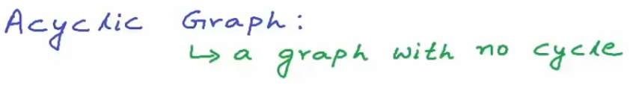
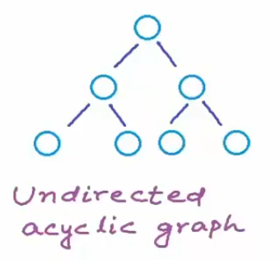
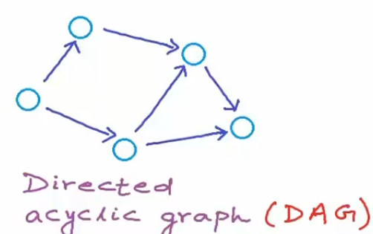
Properties of Graphs

Slide 18
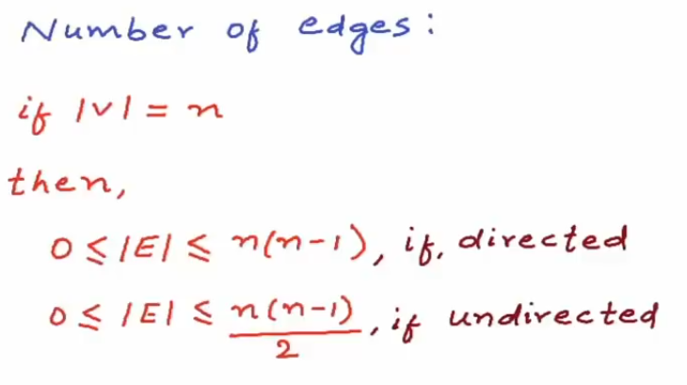
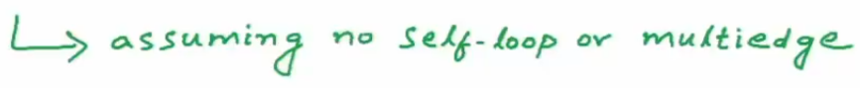
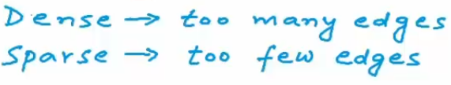
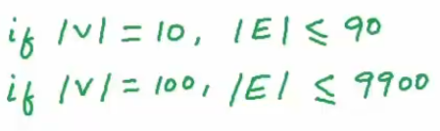
Properties of Graphs

Slide 19
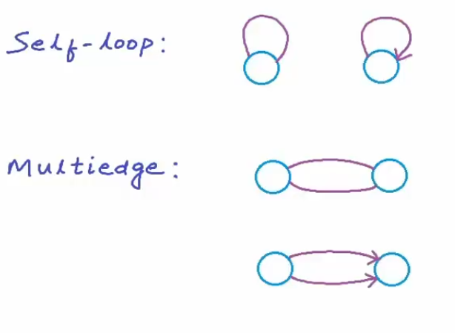
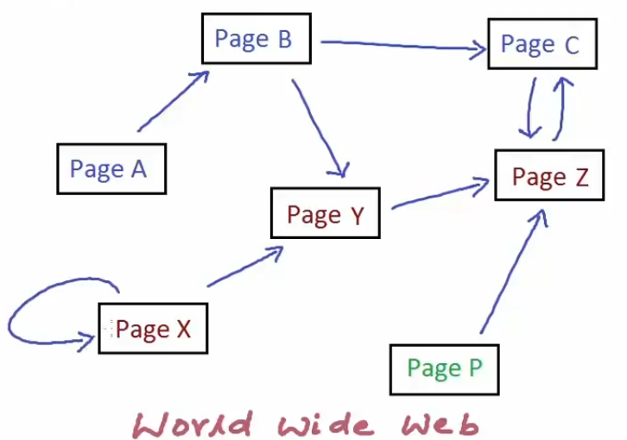
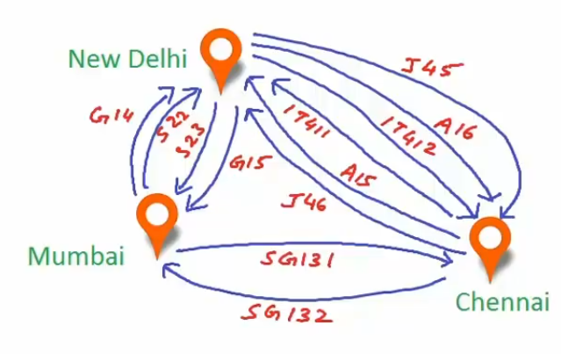
Properties of Graphs

Slide 20
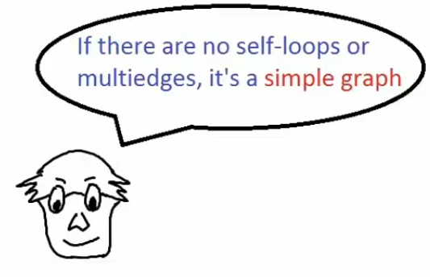
Properties of Graphs

Slide 21
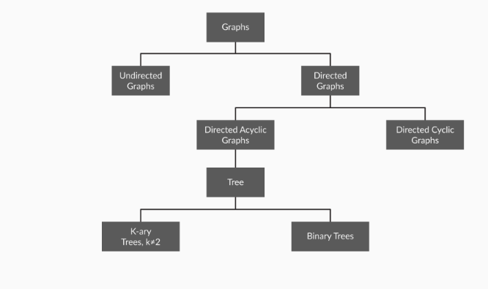
Classification of Graphs
Table

Slide 22
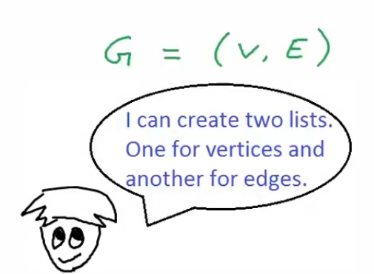
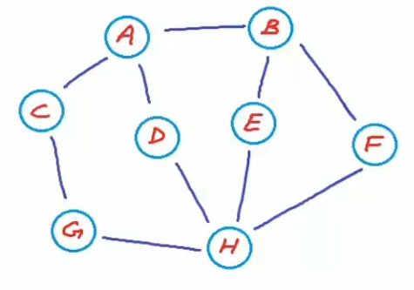
Representation of Graphs
Edge List Representation

Slide 23
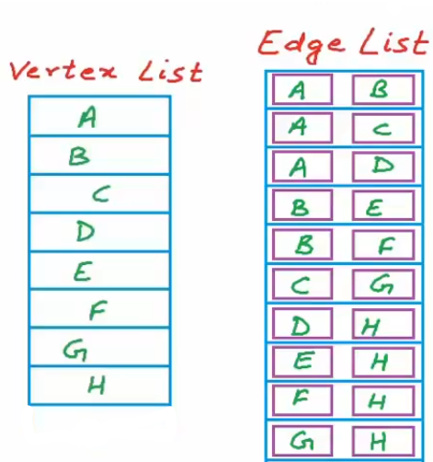
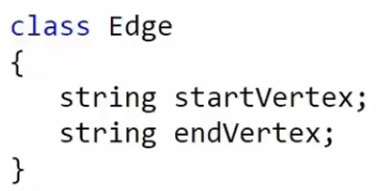
Representation of Graphs
Edge List Representation

Slide 24
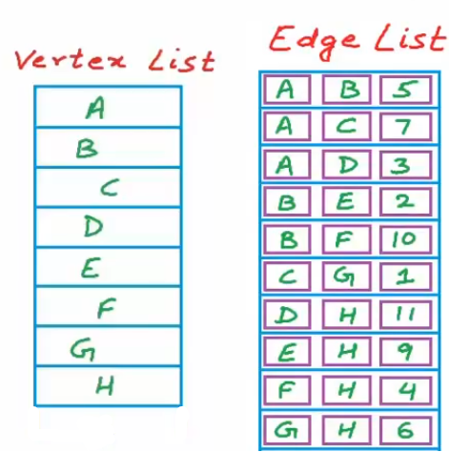
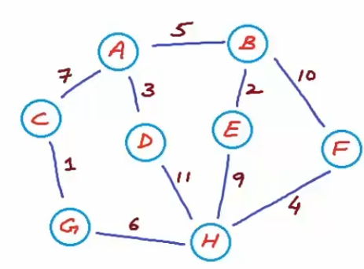
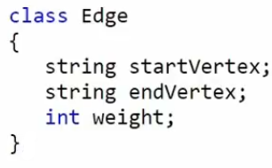
Representation of Graphs
Edge List Representation

Slide 25
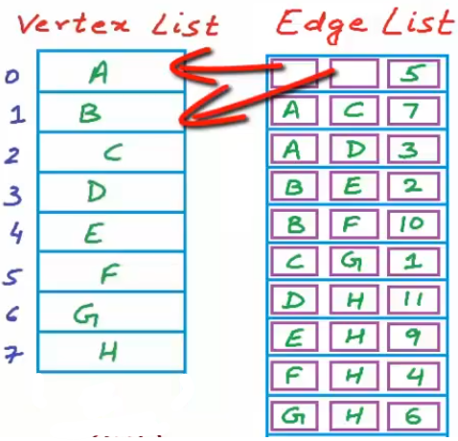
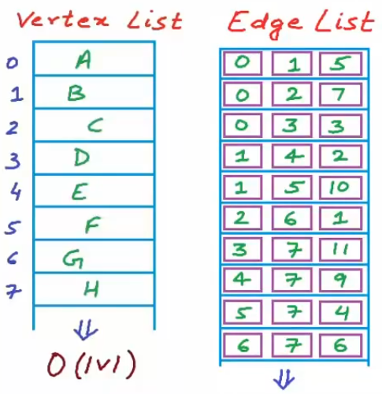
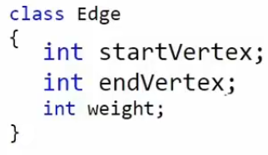
Representation of Graphs
Edge List Representation – A better Representation

Slide 26

Representation of Graphs
Edge List Representation

Slide 27




Representation of Graphs
Edge List Representation – Cost of Operations

Slide 28




Representation of Graphs
Adjacency Matrix Representation

Slide 29


Representation of Graphs
Adjacency Matrix Representation – Cost of Operations

Slide 30



Representation of Graphs
Adjacency Matrix Representation – Cost of Operations

Slide 31

Representation of Graphs
Adjacency Matrix Representation – When favorable?

Slide 32




Representation of Graphs
Adjacency List Representation

Slide 33


Representation of Graphs
Adjacency List Representation – Cost of Operations
But, we already know that we won’t hit the worst case, so we’ll be really saving a lot in terms of time.

Slide 34

Representation of Graphs
Adjacency List Representation

Slide 35

Representation of Graphs
Adjacency List Representation
A better approach to increase the neighbour for any node, i.e. add an edge in the graph.

Slide 36
Representation of Graphs
Adjacency List Representation

Slide 37

Representation of Graphs
Adjacency List Representation
If the edges are weighted.

Slide 38
Representation of Graphs
Adjacency List Implementation using LinkedList

Slide 39
THANK YOU

